Slide 1
MODEL RECOMMENDATION
ONLINE SHOPPER PURCHASING INTENT
Presentation by Jing Du & Minji Kim
BZAN3307: Machine Learning
Prof. VanderWerf
Dec. 3, 2022
Notes:
15 sec

Slide 2
TABLE OF CONTENTS
1.
4.
2.
5.
3.
6.
CLIENT AND PROBLEM
MODELS WITH OVERSAMPLED DATA
Retailer X
Predicting online purchases
Oversampled minority class
ADVANCED METHODS
OUR DATA
Dealing with the rare events problem and overfitting
What are the IVs and DVs of interest?
BASIC MODELS
Results of six basic classification models
OUR RECOMMENDATION STRENGTHS AND LIMITATIONS
Weighing the criteria of our recommendation
Notes:
30 seconds

Slide 3
CLIENT AND PROBLEM
E-COMMERCE INDUSTRY LANDSCAPE
CLIENT AND PROBLEM
Fast-growing market with increasing overall revenue and number of online shoppers
Many opportunities for online retailers
Disadvantages: intense competition for consumers, low conversion rate
Definition of conversion rate: percent of users who make the desired action (like making a purchase)
Client: Retailer X, specifically managers in the sales and marketing departments
Requested highly accurate way of predicting if a customer will complete a purchase and a way to identify likely profiles of purchasers/non-purchasers
Our model could be used for implementing effective sales and website design strategies
Notes:
1min
Advantages of e-commerce: fast-growing market with increasing revenue and number of online shoppers → many opportunities.
Disadvantages: intense competitions and consumers and low conversion rate.
Definition of Conversion Rate: A percent of users who make the desired actions.
How to solve the problem: Finding out which factors determine the buyer behavior through the machine learning techniques.
Client: Retailer X, specifically managers in the sales and marketing departments because if they make more effective sales strategies based on our prediction, both customer satisfaction and sales will increase.

Slide 4
INTRO TO OUR DATASET
Each row represents a different online shopping session in a one-year period
Published by the University of Irvine, obtained via Kaggle
18 columns in total:
IVs: Administrative, Administrative_Duration, Informational, Informational_Duration, ProductRelated, ProductRelated_Duration, BounceRates, ExitRates, PageValues, SpecialDay, Month, OperatingSystems, Browser, Region, TrafficType, VisitorType, Weekend
DV: Revenue
12,330 ROWS/SESSIONS
No Purchase
Complete Purchase
10,422 sessions
1,908 sessions
Notes:
45 sec

Slide 5
Comparison between Classification Algorithms
Using Original Data
Accuracy (%) | Regression | Tree03 | KNN03 | NN11 | Naive | SVM29
Train | 88.67% | 90.08% | 92.60% | 92.74% | 82.71% | 88.37%
Complete Purchase | 40% | 68% | 68% | 69% | 10% | 34%
Test | 88.26% | 89.43% | 88.64% | 89.19% | 83.16% | 87.94%
Complete Purchase | 38% | 65% | 53% | 57% | 8% | 31%

Slide 6
Comparison between Classification Algorithms
Using Oversampled Data
Accuracy (%) | Regression | Tree03 | KNN03 | NN11 | Naive | SVM29
Train | 82.55% | 84.99% | 95.29% | 91.96% | 65.34% | 84.33%
Complete Purchase | 79% | 81% | 100% | 95% | 69% | 83%
AUC | 82.60% | 85.04% | 95.23% | 91.91% | 65.29% | 84.35%
Test | 80.84% | 84.29% | 65.87% | 81.32% | 63.47% | 80.36%
Complete Purchase | 76% | 80% | 47% | 78% | 66% | 75%
AUC | 80.68% | 84.16% | 65.28% | 81.21% | 63.53% | 80.20%

Slide 7
Methods to Prevent Overfitting
% | Tree03 | k-fold_tree cp=0.001096792 | k-fold_KNN k=1 | k-fold_NN size=12 | Random Forest
Average Accuracy | - | 87.30% | 94.57% | 88.39% | -
Train | 84.99% | 89.06% | 100.00% | 90.50% | 100%
Complete Purchase | 81% | 90% | 100% | 93% | 100%
AUC | 85.04% | 89.04% | 100.00% | 90.46% | 100%
Test | 84.29% | 84.16% | 63.89% | 79.83% | 80.68%
Complete Purchase | 80% | 82% | 34% | 74% | 67%
AUC | 84.16% | 84.09% | 62.97% | 79.65% | 80.23%

Slide 8
Final Model
Oversampled Classification Tree with cp=0.001096792
(k-fold cross validation)

Slide 9
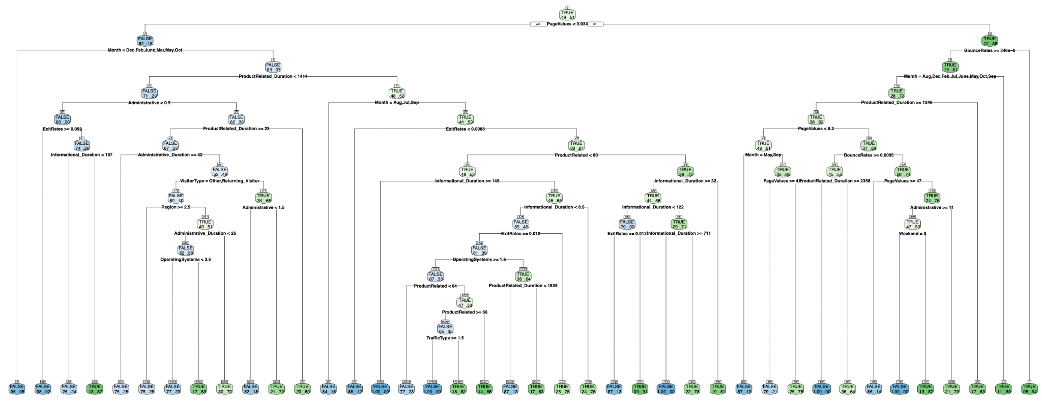
VISUAL OF OUR RECOMMENDATION

Slide 10
CRITERIA FOR CHOOSING OUR MODEL
OVERALL ACCURACY
RARE EVENT ACCURACY
High overall accuracy in test dataset based on AUC and % correct
Oversampling procedure boosts rare event accuracy, addressing Retailer X’s predominant concern with purchaser profiles
RELATIVE EFFICIENCY
ABILITY TO MAKE RULES OF THUMB
Client can identify profiles of hypothetical customers and very accurately predict if they would make a purchase
Far fewer IV columns than several other models, no dimension reduction needed
Notes:
overall accuracy, rare events accuracy, AUC, probability of overfitting, and the ability for our client to quickly develop rules of thumb for online shopper purchasing behavior.

Slide 11
MODEL LIMITATIONS
TREE COMPLEXITY
Lots of branches, takes time to run through tree
RELIANCE ON INTERDEPENDENT RELATIONSHIPS
TIME HORIZON
Does not show overall significance of stand-alone variables
Data only covers a one-year time period, long-term applicability is unknown
TRANSPARENCY
OVER-OPTIMISM
Reading decision trees can be confusing for non-stats backgrounds
Joint application of oversampling and cross validation creates overoptimism
Notes:
2.5 min for slides 8-11

Slide 12
THANK YOU!
Any questions?

